Slide 1
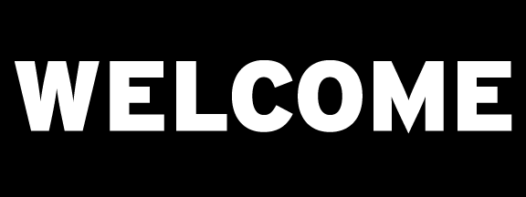

Introduction to Machine Learning
DBDA.X408.(33)
Instructor:
Bill Chen
UCSC Silicon Valley Extension
E: xchen375@ucsc.edu

Slide 2
Week 8
Unsupervised Learning.
Anomaly Detection.
Final Project Touch-up.
Download from: https://drive.google.com/file/d/18BGj39vlQMC4MVyEmsR1idRzYk9C46Ce/view?usp=drive_link
Google drive: https://drive.google.com/drive/folders/1jgfM6s5H5-bzShH4SqogKc3zGUnufQBo

Slide 3
Professional Data Science Background with Python
Basics of Deep Learning – Have trained a DNN
Prerequisites
Notes:
This course is designed for people who have professional experience in data science, specifically with Python, along with some exposure to deep learning. If you have trained a neural network, you should be fine.

Slide 4
Introduction to Anomaly Detection
Supervised Learning with XGBoost
Break
Unsupervised Learning with Autoencoders
Unsupervised Learning with GANs
Assessment: Apply one technique to a new dataset
Agenda
Notes:
Throughout the day, you’ll learn the following techniques by working to solve the same problem: Detecting network intrusions. You will likely see many other applications for what you’ll learn, but we’ll use this use case so you have something real to attach it to. By the end of the day, you should be able to apply any of these techniques to a new dataset and detect anomalies.

Slide 5
Introduction to Anomaly Detection

Slide 6
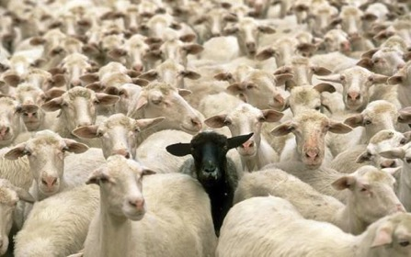
WHAT IS AN ANOMALY?
A data point which differs significantly from other data points
An observation that is likely generated by a different mechanism
Finding anomalies can be useful in telecom/sp networks, cyber security, finance, industry, IOT, healthcare, autonomous driving, video surveillance, robotics.
Many other problems can be framed as anomaly detection: customer retention, targeted advertising.

Slide 7

SPOT THE ANOMALY

Slide 8
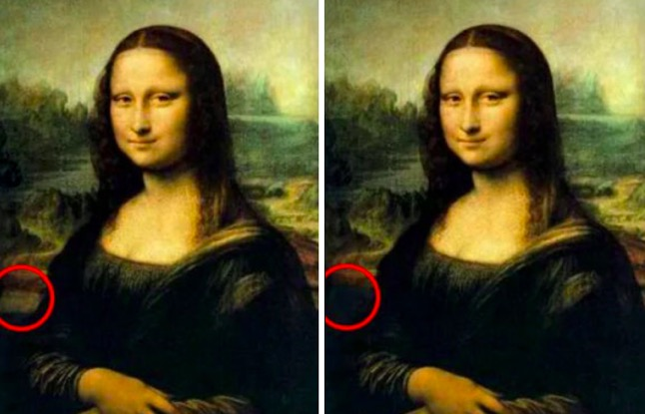
SPOT THE ANOMALY

Slide 9

EXERCISE
What are some of the scenarios that produce anomalies in your organization/domain?
What data sources might affect or record those anomalous activities?
What kind of data analytics techniques could be applied or have been applied to detect those events?

Slide 10
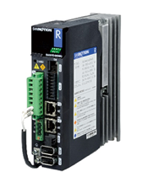
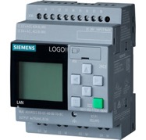


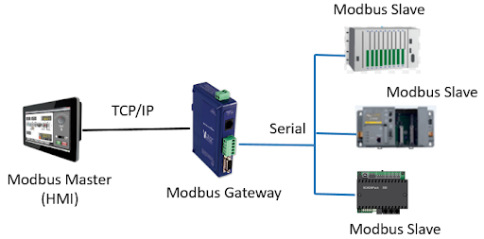

Why is Anomaly Detection Important?
Case Study
Supervisory control and data acquisition (SCADA)
Programmable Logic Controllers (PLCs)

Slide 11
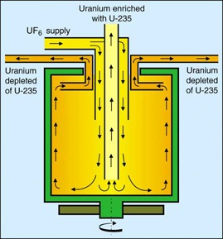
The Stuxnet Worm
Case Study
A 500-kilobyte malicious computer worm that targets SCADA systems.
Spread:
Through infected removable drives such as USB flash drives.
Operation:
Analyzed and targeted Windows networks and computer systems.
Compromised the Step7 software, the worm gained access to 45 S7 to the PLCs.
Virus modified project communication configurations for the PLC’s Ethernet ports
Result:
Infected over 100,000 computers & 22 Manufacturing sites
Appears to have impacted Natanz nuclear facility destroying 984 uranium enriching centrifuges.

Slide 12
DATASET
At a glance!
Name | KDD99 Intrusion Detection Dataset Publicly available at http://kdd.ics.uci.edu/databases/kddcup99/kddcup99.html
Size | 743 Mb
No. of Features | Numeric = 22 ; Categorical = 9
No. of Rows | 18 Million
No. of Classes | 23 (Including the Normal category)
Variable Types | Numeric & Categorical
Goal | Detect Anomalies by studying Network Packet logs

Slide 13
DATASET
Basic Features | Content Features | Traffic Features
duration | hot | count
protocol_type | num_failed_logins | serror_rate
service | logged_in | rerror_rate
src_bytes | num_compromised | same_srv_rate
dst_bytes | root_shell | diff_srv_rate
flag | su_attempted | srv_count
land | num_root | srv_serror_rate
wrong_fragment | num_file_creations | srv_rerror_rate
urgent | num_shells | srv_diff_host_rate
 | num_access_files
 | num_outbound_cm
 | is_hot_login
 | is_guest_login
Numerical
Categorical
Detailed Description @
https://kdd.ics.uci.edu/databases/kddcup99/task.html

Slide 14
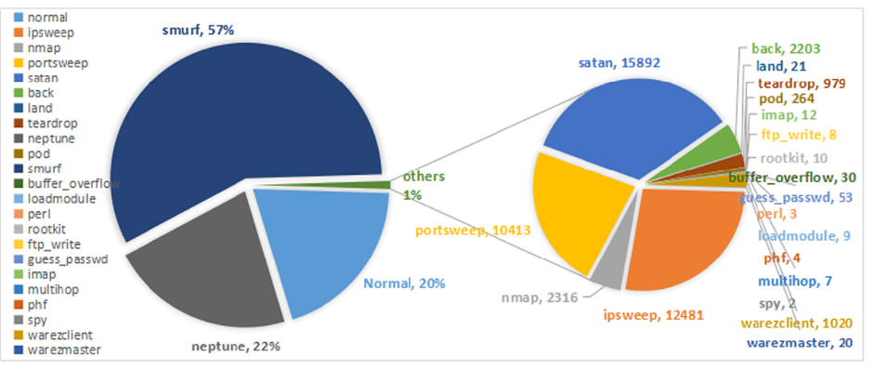
DATASET
Visualization by class

Slide 15
Handling Time Series Data
For Classification
Averaging Features
Duration | Feature 1 | Feature 2 | Feature 3
1 | Avg(Val_1,Val_4) | Avg(Val_2,Val_5) | Avg(Val_3,Val_6)
1 | Avg(Val_7,Val_10) | Avg(Val_8,Val_11) | Avg(Val_9,Val_12)
Time | Feature 1 | Feature 2 | Feature 3
00:00:00 | Val_1 | Val_2 | Val_3
00:00:01 | Val_4 | Val_5 | Val_6
00:00:02 | Val_7 | Val_8 | Val_9
00:00:03 | Val_10 | Val_11 | Val_12
Sampling Features
Duration | Feature 1 | Feature 2 | Feature 3
1 | Val_4 | Val_5 | Val_6
1 | Val_10 | Val_11 | Val_12

Slide 16
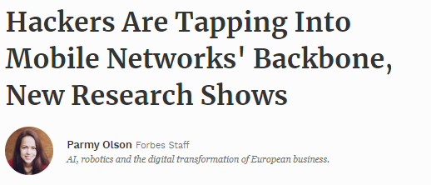
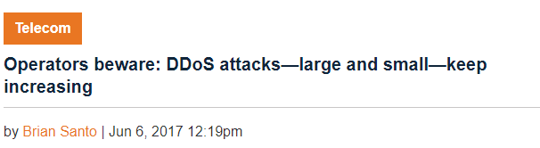
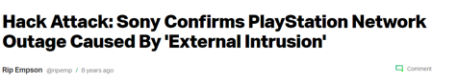
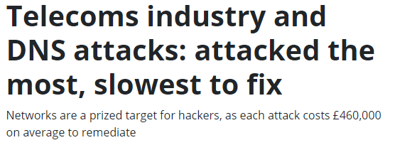
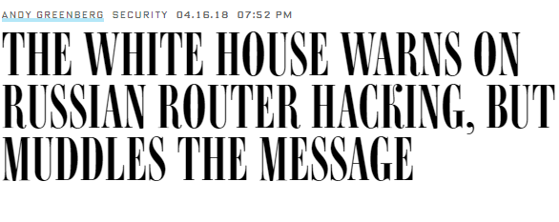
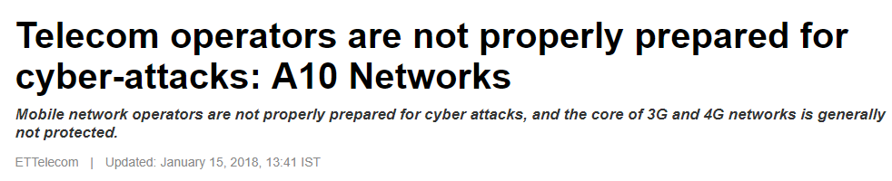
IN THE NEWS
https://www.forbes.com/sites/parmyolson/2015/10/14/hackers-mobile-network-backbone-ss7/#59d777f85142
https://techcrunch.com/2011/04/23/hack-attack-sony-confirms-playstation-network-outage-caused-by-external-intrusion/
https://www.information-age.com/telecoms-industry-dns-attacks-attacked-slowest-fix-123469037/
https://www.wired.com/story/white-house-warns-russian-router-hacking-muddles-message/
https://telecom.economictimes.indiatimes.com/news/telecom-operators-are-not-properly-prepared-for-cyber-attacks-a10-networks/62504221

Slide 17
ANOMALY DETECTION IN NETWORKS
Why do we need it in Telecom ?
What sort of data can we leverage?
NetFlow Data
Telecom Fraud
$38 Billion
Time Series Based
Encrypted Traffic Data
Machine Exhaust Data
Network Anomaly Detection
Network / IP Fraud $12 Billion
Equipment/User Metadata
Feature Based
Aggregations
Temporal Features

Slide 18


DETECTION METHODS IN THIS COURSE
Anomaly Detection
Supervised
(When you have Labels)
Unsupervised
(When you don’t have labels for your data)
XGBoost
Autoencoders
Generative Adversarial Networks

Slide 19
GPU ACCELERATED XGBOOST

Slide 20



XGBOOST
Definition
XGBoost is an implementation of gradient boosted decision trees designed for speed and performance.
It is a powerful tool for solving classification and regression problems in a supervised learning setting.
Notes:
The input is usually a vector.
[ˈneɪbə^{r}]

Slide 21
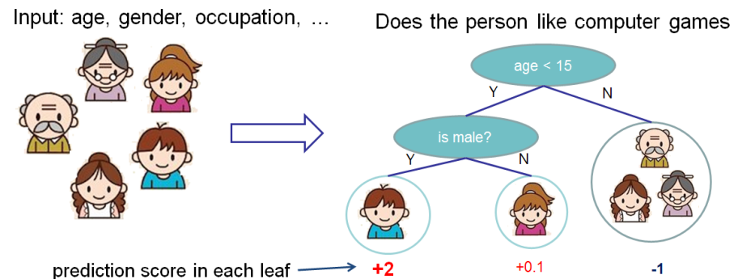
PREDICT: WHO ENJOYS COMPUTER GAMES
Example of Decision Tree
Source: https://goo.gl/eTxVtA

Slide 22
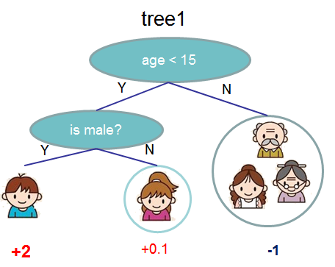
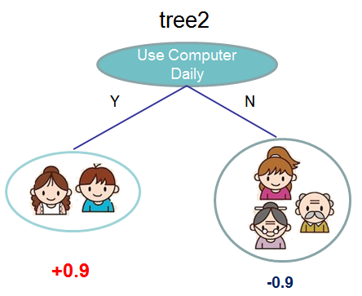
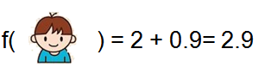
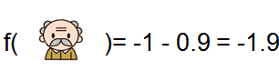
ENSEMBLE DECISION TREES
Source: https://goo.gl/eTxVtA

Slide 23
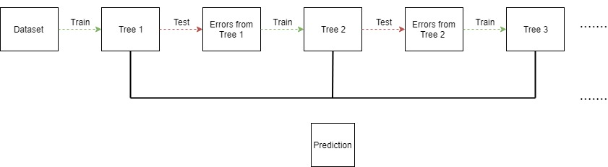
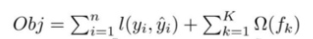
GRADIENT BOOSTED TREES FOR STRONGER PREDICTIONS
Complexity of the Trees
Build trees one at a time, where each new tree helps to correct errors made by previously trained tree.
Training Loss

Slide 24
XgBoost
Intuitive Example for Tree Construction
Step 1: Start as a single leaf
Input all residuals
-10.5, 6.5, 7.5, -7.5
15
10
Step 2: Calculate similarity score
For all residuals
Set Threshold @ Arbitrary Drug Dosage 15
Sum of residuals squared
No. of residuals + Regularization
0
Effectiveness
-10.5, 6.5, 7.5, -7.5
S0 = 4
Setting Reg = 0
-15
0
20
40
Drug Dosage
https://www.youtube.com/watch?v=OtD8wVaFm6E

Slide 25
XgBoost
Intuitive Example for Tree Construction
Step 3: Calculate Similarity Score
For Left and Right Sub Trees
-10.5, 6.5, 7.5, -7.5
15
10
S10 = 110.25
Setting Reg = 0
-10.5
6.5, 7.5, -7.5
S11 = 14.08
Setting Reg = 0
0
Effectiveness
Step 4: Calculate Gain
Lower Leaves cluster similar residuals than root ?
Gain = Left Similarity + Right Similarity
– Root Similarity
-15
0
20
40
G1 = 120.33
Drug Dosage

Slide 26
XgBoost
Intuitive Example for Tree Construction
Step 5: Calculate Similarity Score
For Left and Right Sub Trees
Dosage < 22.5
22.5
10
S10 = 8
Setting Reg = 0
-10.5 , 6.5
7.5, -7.5
S11 = 0
Setting Reg = 0
0
Effectiveness
Step 6: Calculate Gain
Lower Leaves cluster similar residuals than root ?
Gain = Left Similarity + Right Similarity
– Root Similarity
-15
0
20
40
G2 = 4
Drug Dosage
Since G2 = 4 < G1 = 120.33
Tree 1 had better split

Slide 27
XgBoost
Intuitive Example for Tree Construction
Step 7: Calculate Similarity Score
For Left and Right Sub Trees
Dosage < 30
30
10
S10 = 4.08
Setting Reg = 0
-10.5 , 6.5, 7.5
-7.5
S11 = 56.25
Setting Reg = 0
0
Effectiveness
Step 6: Calculate Gain
Lower Leaves cluster similar residuals than root ?
Gain = Left Similarity + Right Similarity
– Root Similarity
-15
0
20
40
G3 = 56.33
Drug Dosage
Since G3 = 56.33 < G1 = 120.33
Tree 1 had better split

Slide 28
XgBoost
Intuitive Example for Tree Construction
Dosage <15
22.5
10
S10 = 110.25
Setting Reg = 0
-10.5
Dosage < 22.5
S11 = 14.08
Setting Reg = 0
0
Effectiveness
Step 8: Calculate Similarity Score
For Left and Right Sub Trees ( 2nd Level)
-15
S21 = 42.25
Setting Reg = 0
6.5
7.5, -7.5
S21 = 0
Setting Reg = 0
0
20
40
Drug Dosage
Step 9: Calculate Gain
Lower Leaves cluster similar residuals than root ?
G12 = 42.25 – 14.0 = 28.17

Slide 29

XgBoost
Intuitive Example for Tree Construction
Step 10: Calculate Similarity Score
For Left and Right Sub Trees
Dosage <15
30
10
S10 = 110.25
Setting Reg = 0
-10.5
Dosage < 22.5
S11 = 14.08
Setting Reg = 0
0
Effectiveness
Output = -10.5
Step 11: Calculate Gain
Lower Leaves cluster similar residuals than root ?
-15
S21 = 98
Setting Reg = 0
6.5, 7.5
-7.5
S21 = 56.25
Setting Reg = 0
0
20
40
Drug Dosage
G21 = 140.17 > G12
Step 12:
Calculate Output Value =
Sum of residuals squared
Output = 7
Output = -7.5
No. of residuals + Regularization

Slide 30
XgBoost
Intuitive Example for Tree Construction
Re - Calculate Residuals :
Assuming Gradient Multiplier = 0.3
R1 : 0.5 + 0.3 (-10.5) = - 2.65
R2 : 0.5 + 0.3(7) = 2.6
R3 : 0.5 + 0.3(7) = 2.6
R4 : 0.5 + 0.3(-7.5) = -1.75
Dosage <15
S10 = 110.25
Setting Reg = 0
-10.5
Dosage < 22.5
S11 = 14.08
Setting Reg = 0
Output = -10.5
Step 13:
Construct new tree with updated Residuals
S21 = 98
Setting Reg = 0
6.5, 7.5
-7.5
S21 = 56.25
Setting Reg = 0
G21 = 140.17 > G12
Output = 7
Output = -7.5

Slide 31
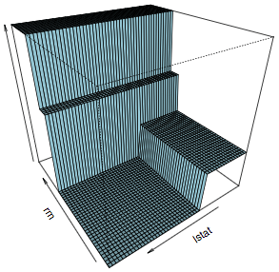
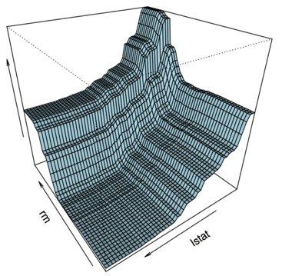
TRAINED MODELS VISUALIZATION
Single Decision Tree vs Ensemble Decision Trees
Models fit to the Boston Housing Dataset
Source: https://goo.gl/GWNdEm

Slide 32
XgBoost
XgBoost
Optimized version of GBT incorporating parallelism, tree pruning and regularization.
Building up from a Decision Tree
Gradient Boosting
Utilize Gradient Descent to minimize errors in the sequentially built trees.
Boosting
Trees built sequentially minimizing errors from previous trees and weighing better performing ones more.
Random Forest
Utilize random subsets of a dataset to build multiple decision trees
Bagging
Ensemble of multiple decision trees to arrive at decision through majority voting
Decision Trees
Tree based algorithm that outputs decisions based on certain conditions.

Slide 33
WHY XGBOOST?

Slide 34

ROC CURVE
Construction
Move Threshold
 |  | Actual
 |  | Anomaly | Not Anomaly
Predicted | Anomaly | TP | FP
 | Not Anomaly | FN | TN
1
True Positive Rate
True Positive Rate
TP / (TP+FN) = Sensitivity
False Positive Rate
FP / (FP +TN)
0
1
False Positive Rate
https://www.youtube.com/watch?v=4jRBRDbJemM

Slide 35
ROC CURVE
Construction
Move Threshold
 |  | Actual
 |  | Anomaly | Not Anomaly
Predicted | Anomaly | TP | FP
 | Not Anomaly | FN | TN
1
True Positive Rate
AUC
True Positive Rate
TP / (TP+FN) = Sensitivity
False Positive Rate
FP / (FP +TN)
0
1
False Positive Rate

Slide 36
ROC CURVE
Interpretation
True Positive Rate
Number of Samples
AUC = 0.99 ~1
0
1
0
1
0.5
False Positive Rate
Probability Score

Slide 37
ROC CURVE
Interpretation
True Positive Rate
Number of Samples
AUC = 0.5
0
0.5
1
0
1
False Positive Rate
Probability Score
Better the separation between the classes = Better Model / Classifier

Slide 38
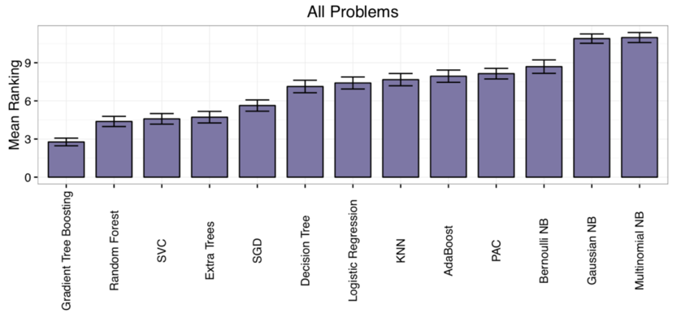
WHICH ML ALGORITHM PERFORMED BEST
Average rank across 165 ML datasets
Lower
Is
Better
Source: https://goo.gl/R8Y8Pp

Slide 39

RAPIDS
End-to-End Accelerated GPU Data Science
Data Preparation
Model Training
Visualization
Dask
cuDF cuIO
Analytics
cuML
Machine Learning
cuGraph
Graph Analytics
PyTorch, TensorFlow, MxNet
Deep Learning
cuxfilter, pyViz, plotly
Visualization
GPU Memory
Notes:
RAPIDS is an open source framework which tries to accelerate the end-to-end
data science pipeline by using GPUs and GPU memory rather than CPU and CPU
memory.
It is a set of libraries, and each of them covers a different objective.
Today, we will focus on a couple of these libraries:
cuDF for data prep and feature engineering and cuML, which is the library
which contains the most used machine learning algorithms, such as PCA, K-Means,
KNN, and many others.
Nevertheless, there are other libraries which I would like to mention too.
We have recently released a new library, cuGraph, for graph analytics.
Also, we will be releasing soon a library named cuIO, for ETL purposes.
For data visualization we have cuXFilter, a JavaScript library based on
CrossFilter, and which allows you to explore datasets in the browser.

Slide 40
WHY RAPIDS + XGBOOST?

Slide 41
TIME TO TRAIN
Rapid Data Science
Model Selection and Hyper-Parameter Tuning
best_model = init_model
for (m,h) in zip(models, hyperparams):
my_model = train(m,h)
if acc(my_model) > acc(best_model):
best_model = my_model
Test Set Accuracy
Test Set Accuracy
Size of Training Data
Number of Models Trained

Slide 42
RAPIDS WITH XGBOOST
Multi-GPU, Multi-Node, Scalability
XGBoost:
Algorithm tuned for eXtreme performance and high efficiency
Multi-GPU and Multi-Node Support
RAPIDS:
End-to-end data science & analytics pipeline entirely on GPU
User-friendly Python interfaces
Relies on CUDA primitives, exposes parallelism and high-memory bandwidth
Benefits from DGX system designs (NVLINK, NVSWITCH, dense compute platform)
Dask integration for managing workers & data in distributed environments

Slide 43
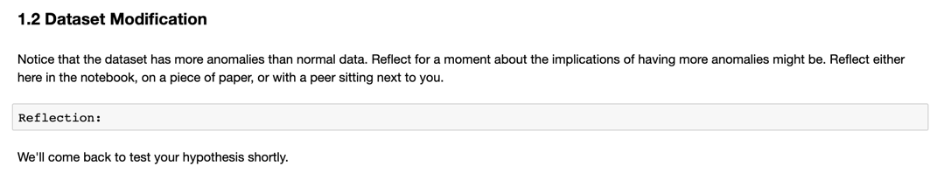
Work through the first reflection
Notes:
Host a discussion

Slide 44
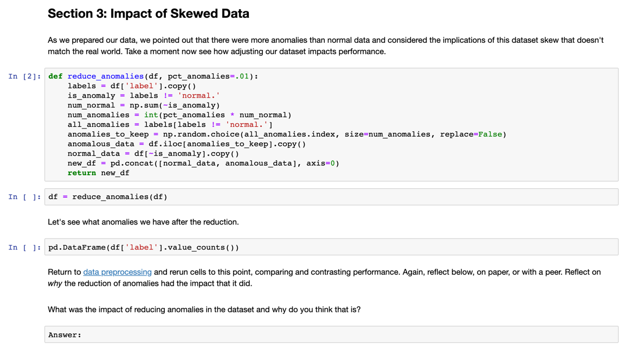
Train a binary classifier and stop here
Notes:
Guide students to implement and rerun everything hosting a discussion after.

Slide 45
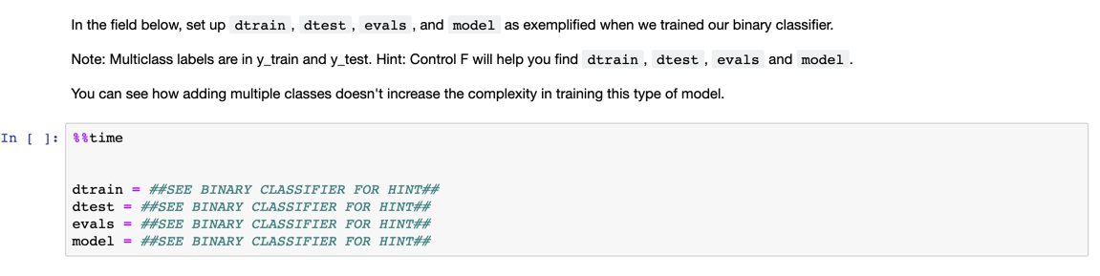
Multi-Class Classifier Challenge
Notes:
Guide students to implement and rerun everything hosting a discussion after.

Slide 46
Exercise 2 WHAT IF YOU DID NOT HAVE LABELS FOR YOUR DATASET ?

Slide 47
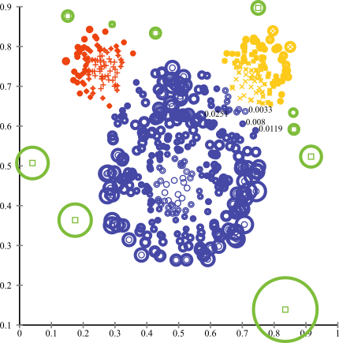
UNSUPERVISED DETECTION METHODS
Statistical, proximity, and deviation
Statistical methods assume that the data can be modeled from a specific distribution
Anomalous if probability is less than threshold
Proximity methods use distance to define anomalies
Anomalous if distance from centroid greater than threshold
Deviation methods use lower-dimensional embeddings and reconstruction error
Anomalous if reconstruction error is greater than one or standard deviations
https://stats.stackexchange.com/questions/160260/anomaly-detection-based-on-clustering

Slide 48
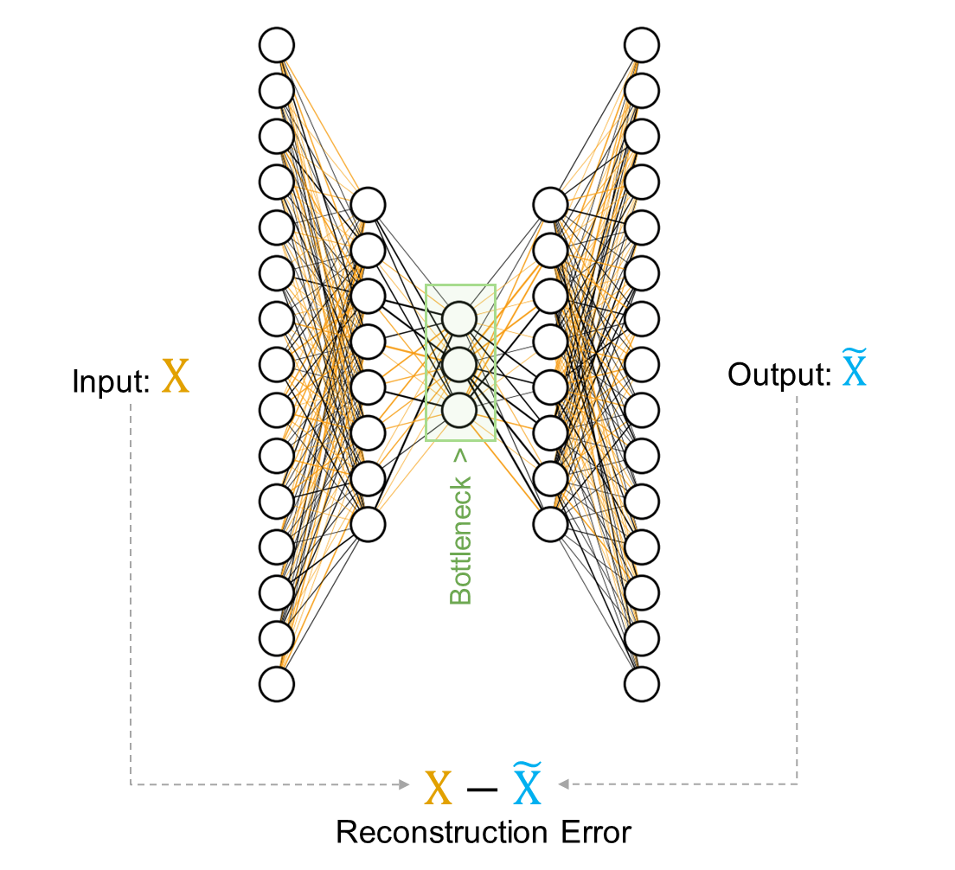
AUTOENCODERS
Deviation based anomaly detection method
Autoencoders are a form of unsupervised learning and have applications outside of anomaly detection
An autoencoder consists of two parts the encoder and decoder
Encoder is a neural network that maps the input to a (typically) lower-dimensional space
Decoder is a neural network that maps the encoded data back to the input
Anomalies have high reconstruction error

Slide 49
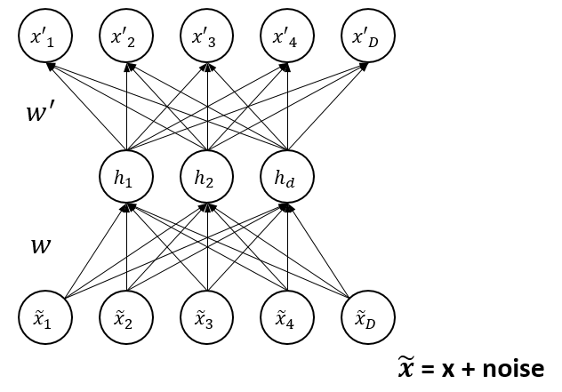
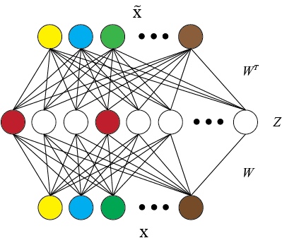
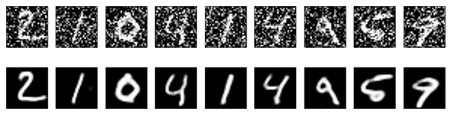
AUTOENCODER FLAVORS
Denoising
Sparse
https://medium.com/@venkatakrishna.jonnalagadda/sparse-stacked-and-variational-autoencoder-efe5bfe73b64
https://blog.keras.io/building-autoencoders-in-keras.html

Slide 50
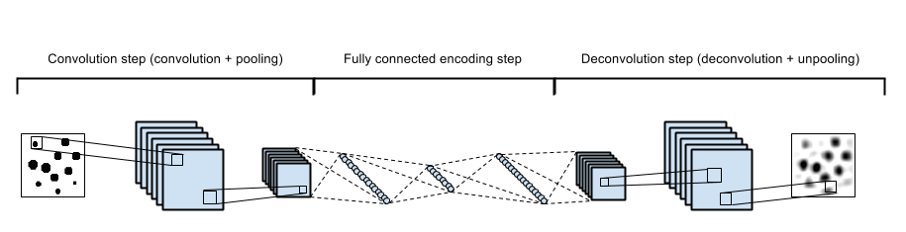
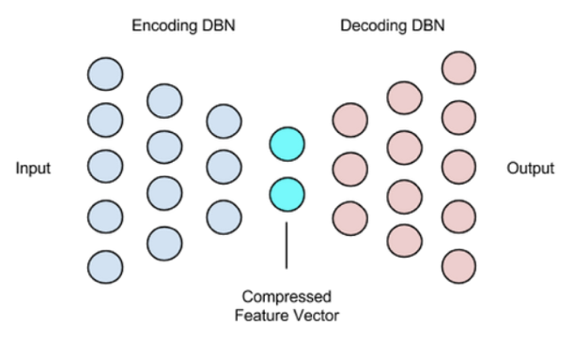
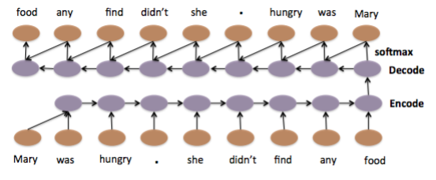
MODULARITY
Convolutional
Deep
https://swarbrickjones.wordpress.com/2015/04/29/convolutional-autoencoders-in-pythontheanolasagne/
LSTM
https://deeplearning4j.org/deepautoencoder
https://arxiv.org/pdf/1506.01057v2.pdf

Slide 51
DEEP AUTOENCODERS

Slide 52
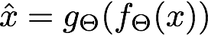
Autoencoder based Anomaly Detection
Input
Data
Reconstructed
Data
Encoder-Net
Decoder-Net
x₁
_{Y1}
duration | 0
src_bytes | 215
service | http (1)
flag | SF (0)
src_bytes | 215
. . .
dst_host_srv_rerror_rate | 1
duration | 0
src_bytes | 215
service | http (1)
flag | SF (1)
src_bytes | 215
. . .
dst_host_srv_rerror_rate | 0
✔
x₂
.
.
.
.
.
.
_{Y2}
✔
x₃
.
.
.
.
.
.
_{Y3}
✔
x₄
.
_{Y4}
✖
.
.
.
.
.
.
.
.
✔
.
.
.
.
.
.
_{Y5}
x₅
.
.
.
.
.
.
.
.
.
.
.
.
.
.
.
.
.
.
.
.
.
.
.
.
.
.
.
.
x_{i}
_{Yi}
✖

Slide 53
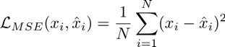
AUTOENCODER RECONSTRUCTION ERROR
Input Data
Encoder-Net
Decoder-Net
Reconstructed Data
✔
x₁
x₁
duration | 0
src_bytes | 215
service | http (1)
flag | SF (0)
src_bytes | 215
. . .
dst_host_srv_rerror_rate | 1
duration | 0
src_bytes | 215
service | http (1)
flag | SF (1)
src_bytes | 215
. . .
dst_host_srv_rerror_rate | 0
✔
x₂
.
.
.
.
.
.
x₂
✔
x₃
.
.
.
.
.
.
x₃
✖
x₄
.
x₄
✔
.
.
.
.
.
.
.
.
x₅
.
.
.
.
.
.
x₅
.
.
.
.
.
.
.
.
.
.
.
.
.
.
.
.
.
.
.
.
.
.
.
.
.
.
.
.
.
x_{i}
✖
x_{i}
Reconstruction Error
x_{i}
Mean-Squared Error (MSE)
x_{i}

Slide 54
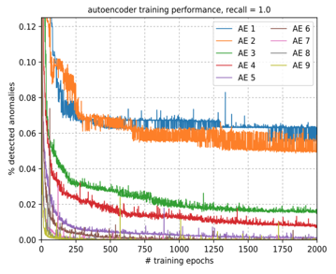
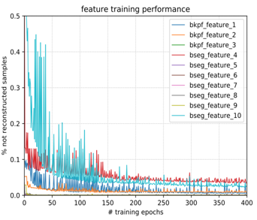
AUTOENCODER RECONSTRUCTION ERROR
Input
Journal Entry
Encoder-Net
Decoder-Net
Reconstructed
Journal Entry
✔
x₁
x₁
duration | 0
src_bytes | 215
service | http (1)
flag | SF (0)
src_bytes | 215
. . .
dst_host_srv_rerror_rate | 1
duration | 0
src_bytes | 215
service | http (1)
flag | SF (1)
src_bytes | 215
. . .
dst_host_srv_rerror_rate | 0
✔
x₂
.
.
.
.
.
.
x₂
✔
x₃
.
.
.
.
.
.
x₃
✖
x₄
.
x₄
✔
.
.
.
.
.
.
.
.
x₅
.
.
.
.
.
.
x₅
.
.
.
.
.
.
.
.
.
.
.
.
.
.
.
.
.
.
.
.
.
.
.
.
.
.
.
.
.
x_{i}
✖
x_{i}
Reconstruction Error – Training Performance
x_{i}
x_{i}

Slide 55
RECONSTRUCTION ERROR OF REGULAR SAMPLE
Encoder-Net
Decoder-Net
x₁
0.0
0.0
1.0
0.0
0.0
…
0.0
0.02
-0.01
1.11
0.0
0.08
…
0.05
x₁
x₂
.
.
.
.
.
.
x₂
z₁
Reconstruction error of a single sample
x₃
.
.
.
.
.
.
x₃
z₂
.
x₄
.
.
.
.
.
.
.
x₄
0.0215
.
.
.
.
.
.
.
x₅
.
.
x₅
.
.
z_{n}
.
.
.
.
.
.
.
.
.
.
.
.
.
.
.
.
.
.
.
.
.
.
.
.
.
x_{i}
x_{i}

Slide 56
RECONSTRUCTION ERROR OF AN ANOMALY
Encoder-Net
Decoder-Net
x₁
0.0
0.0
1.0
0.0
0.0
…
0.0
0.52
0.03
0.01
0.07
-1.08
…
1.45
x₁
x₂
.
.
.
.
.
.
x₂
z₁
Reconstruction error of a single sample
x₃
.
.
.
.
.
.
x₃
z₂
.
x₄
.
.
.
.
.
.
.
x₄
4.5252
.
.
.
.
.
.
.
x₅
.
.
x₅
.
.
z_{n}
.
.
.
.
.
.
.
.
.
.
.
.
.
.
.
.
.
.
.
.
.
.
.
.
.
x_{i}
x_{i}

Slide 57
CATEGORICAL FEATURES
One-hot encoding vs Entity Embedding
 | X1 | C1 | C2
1 | Xa | C1a | C2a
2 | Xb | C1b | C2a
3 | Xc | C1b | C2c
 | X1 | C1a | C1b | C1c | C2a | C2b | C2c
1 | Xa | 1 | 0 | 0 | 1 | 0 | 0
2 | Xb | 0 | 1 | 0 | 1 | 0 | 0
3 | Xc | 0 | 1 | 0 | 0 | 0 | 1
One-hot encoding
C1 | Embedding
C1a | [0.1,0.2,0]
C1b | [0.5,0.7,0.1]
C2 | Embedding
C2a | [-0.5,0.2,0.4]
C2c | [0.3,0.7,0.8]
 | X1 | C11 | C12 | C13 | C21 | C22 | C23
1 | Xa | 0.1 | 0.2 | 0 | -0.5 | 0.2 | 0.4
2 | Xb | 0.5 | 0.7 | 0.1 | -0.5 | 0.2 | 0.4
3 | Xc | 0.5 | 0.7 | 0.1 | 0.3 | 0.7 | 0.8
,
Entity Embedding

Slide 58
EMBEDDING CATEGORICAL FEATURES
Dense Layer 1
Embedding Layer
 | X1 | C1 | C2
1 | Xa | C1a | C2a
2 | Xb | C1b | C2b
3 | Xc | C1c | C2c
Output
Layer
X = Continuous Variable
C = Categorical Variable
Input layer
Flatten
Concat Layer
Dense Layer 2

Slide 59
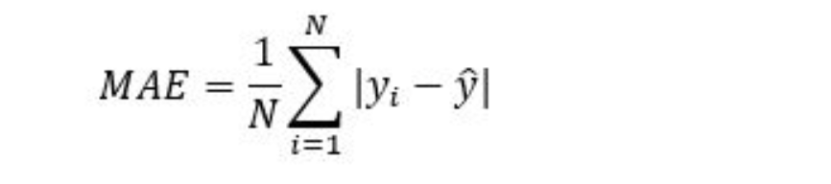
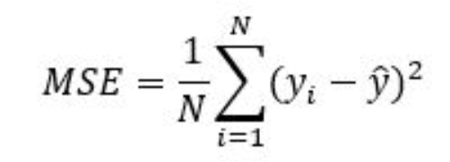
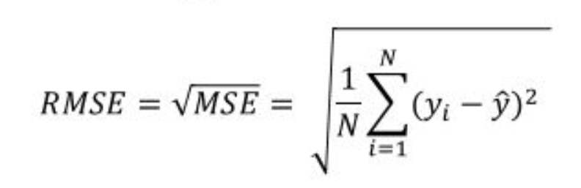
ERROR METRICS
Comparing the different Metrics
Mean Absolute Error (MAE): This measures the absolute average distance between the real data and the predicted data, but it fails to punish large errors in prediction.
Mean Square Error (MSE): This measures the squared average distance between the real data and the predicted data. Here, larger errors are well noted (better than MAE). But the disadvantage is that it also squares up the units of data as well. So, evaluation with different units is not at all justified.
Root Mean Squared Error (RMSE): This is actually the square root of MSE. Also, this metrics solves the problem of squaring the units.

Slide 60
Auto-Encoder on Time-series Data
Bonus
x N
Time | Feature 1 | Feature 2 | Feature 3
00:00:00 | Val_1 | Val_2 | Val_3
00:00:01 | Val_4 | Val_5 | Val_6
00:00:02 | Val_7 | Val_8 | Val_9
00:00:03 | Val_10 | Val_11 | Val_12
Time | Feature 1 | Feature 2 | Feature 3
00:00:00 | Val_1_1 | Val_2_2 | Val_3_3
00:00:01 | Val_4_4 | Val_5_5 | Val_6_6
00:00:02 | Val_7_7 | Val_8_8 | Val_9_9
00:00:03 | Val_10_10 | Val_11_11 | Val_12_12
.
.
.
.
.
.
.
.
.
.
.
Reconstruction Error – Training Performance
.
.
.
.
.
.
.
.

Slide 61
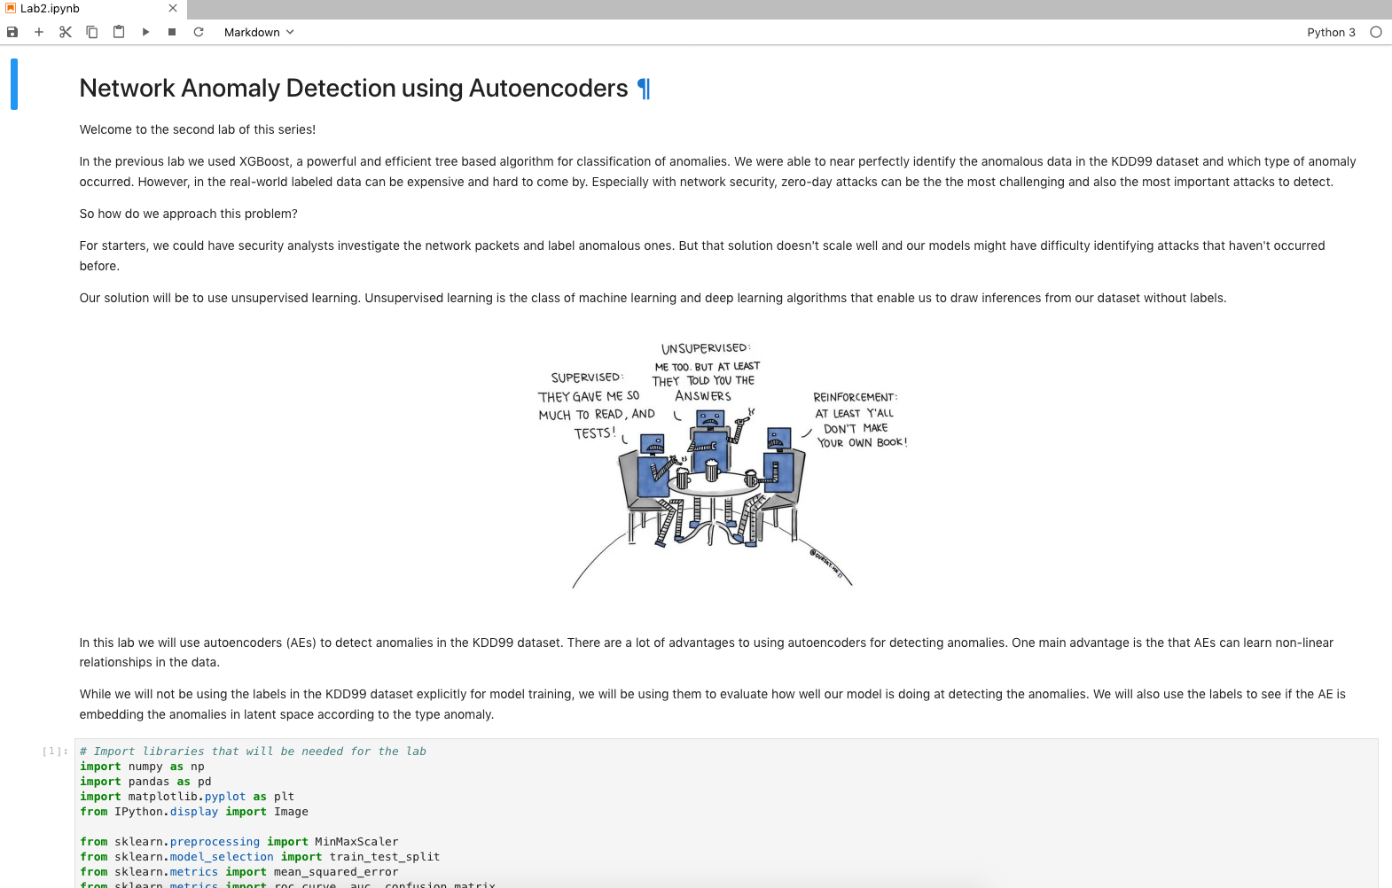
LAB 2 HANDS-ON

Slide 62
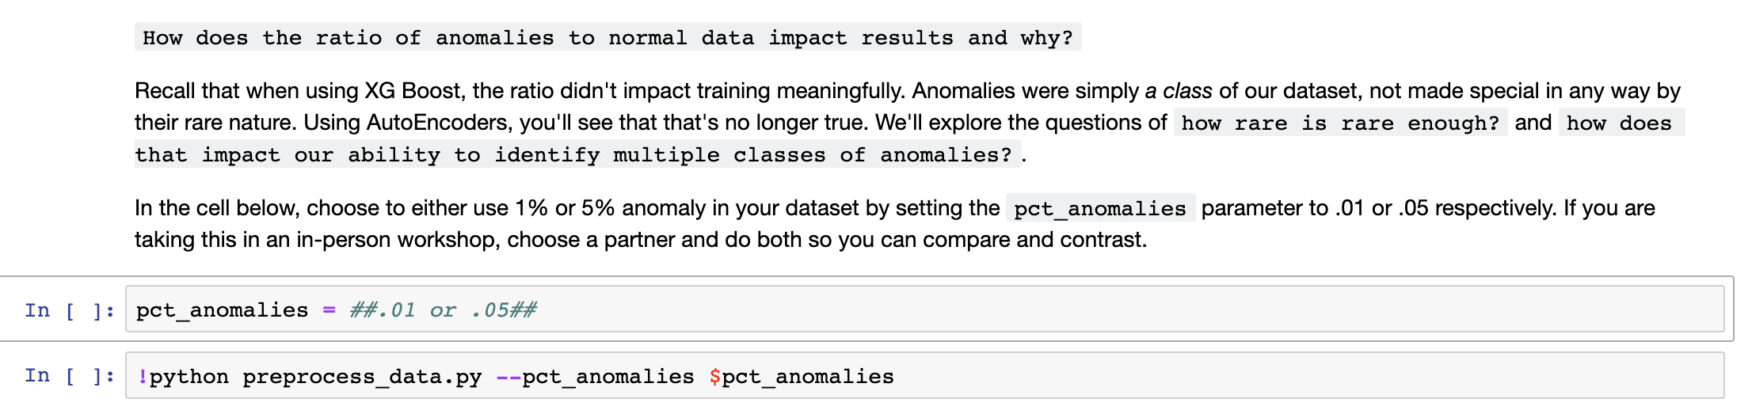
Choose one

Slide 63
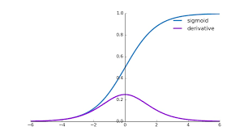
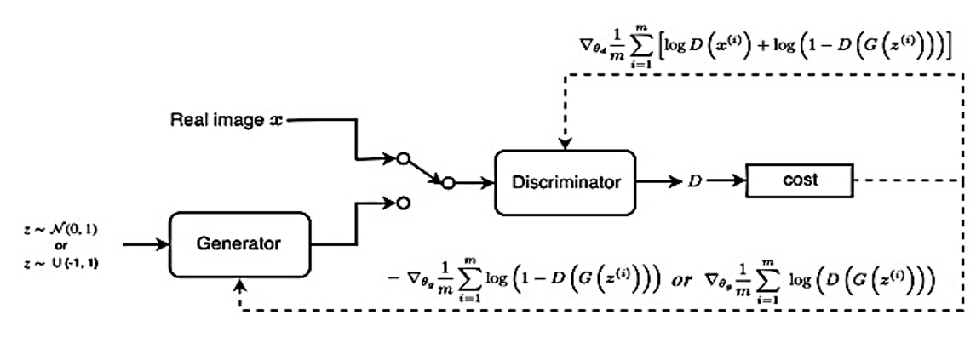
RECAP OF GANs
Problem of Vanishing Gradients
As hidden layers increase the partial derivative terms starts becoming smaller and smaller.
The discriminator doesn't provide enough information for the generator to make progress.
Weak Classifier
Weak Generator
https://medium.com/analytics-vidhya/the-problems-of-generative-adversarial-networks-gans-3d887efa578e

Slide 64
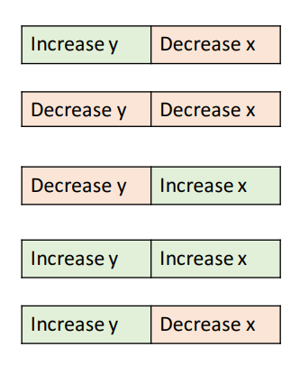
RECAP OF GANs
Problem of Non-Convergence
GANs involve two players
Discriminator is trying to maximize its reward.
Generator is trying to minimize Discriminator’s reward.
SGD was not designed to find the Nash equilibrium of a game.
Problem: We might not converge to the Nash equilibrium at all

Slide 65
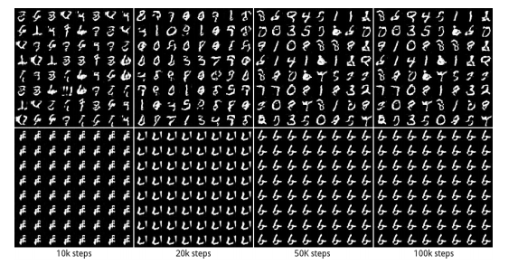
RECAP OF GANs
Problem of Mode Collapse
Generated Distribution
Generated images converge to x^ that fool D the most -- most realistic from the D perspective
Discriminator gets stuck in a local minimum and doesn't find the best strategy.
Generator keeps producing small set of modes or output types.
No Mode Collapse
Mode Collapse
Data Distribution

Slide 66
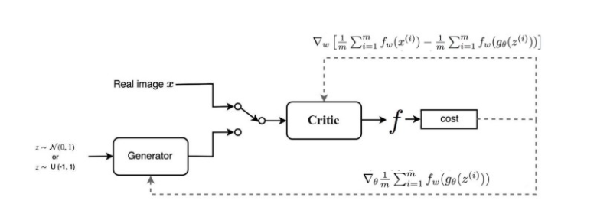
RECAP OF GANS
Some Solutions - WGAN
The major difference is due to the cost function:
Discriminator does not actually classify instances rather outputs a number.
Discriminator training just tries to make the output bigger for real instances than for fake instances => Called a “ critic” than a discriminator.
If the discriminator gets stuck in local minima, it learns to reject the outputs that the generator stabilizes on. So the generator must try something new.
Helps avoid problems with vanishing gradients & model collapse.

Slide 67
RECAP OF GANs
Adversarial Attacks
White – Box attacks :
Attackers have access to Model architecture, weights.
Calculate the perturbation δ based on loss function.
Attackers push the perturbed image to be misclassified to a specific target class.
Black - Box attacks :
Attackers do not have access to the classifier or defense parameters.
Trains a substitute model using a very small dataset augmented by synthetic images labeled by querying the classifier.
Examples that fool the substitute end up being misclassified by the targeted classifier.
Input Data
+
Network
Misclassified output
Perturbation

Slide 68
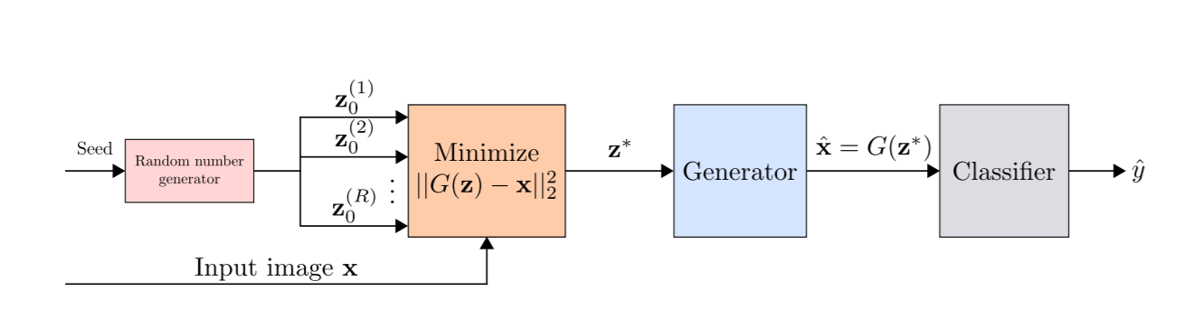
DEFENCE GAN
Pipelining a GAN with Anomaly Detection Classifier
WGAN trained on legitimate (un-perturbed) training samples to “denoise” adversarial examples.
At test time, prior to feeding an image x to the classifier, x is projected onto the range of the generator by minimizing the reconstruction error ||G(z) − x||²₂ and produce output to a given image which does not contain the adversarial changes.
The resulting reconstruction G(z) is then given to the classifier. Results in a substantial reduction of any potential adversarial noise.
https://arxiv.org/pdf/1805.06605.pdf

Slide 69


SHORT RECAP
pct_anomalies = 0.05
pct_anomalies = 0.01

Slide 70
LAB 3
WHAT IF YOU HAD NO IDEA WHAT YOUR ANOMALIES ARE GOING TO LOOK LIKE?

Slide 71
LAB 3
(OR)
YOUR DATA DOES NOT FOLLOW A GAUSSIAN DISTRIBUTION?

Slide 72

GENERATIVE ADVERSARIAL NETWORKS
A generative model that learns to generate samples that have the same characteristics as the samples in the dataset.
The Generator, `G`, produces fake samples
The discriminator, ‘D’, receives samples from both G and the dataset.
During Training: The generator tries to fool the discriminator by outputting values that resemble real data and the discriminator tries to become better at distinguishing between the real and fake data.

Slide 73




GAN APPLICATIONS
pix2pixHD

Slide 74
TRAINING THE GAN
STEP 1
Input
Journal Entry
Output
Journal Entry
duration | %%%%
src_bytes | %%%%
service | %%%%
flag | %%%%
src_bytes | %%%%
. . .
dst_host_srv_rerror_rate | %%%%
Generate Fake Sample
duration | #####
src_bytes | #####
service | #####
flag | #####
src_bytes | ####
. . .
dst_host_srv_rerror_rate | ####
Generator
Meaningless Output

Slide 75
TRAINING THE GAN
duration | #####
src_bytes | #####
service | #####
flag | #####
src_bytes | ####
. . .
dst_host_srv_rerror_rate | ####
STEP 2
Generator Output
Tune Discriminator Weights
Discriminator
0
Output
Score
-
1
duration | 0
src_bytes | 215
service | http (1)
flag | SF (1)
src_bytes | 215
. . .
dst_host_srv_rerror_rate | 0
Real Data Sample
Error

Slide 76

TRAINING THE GAN
STEP 3

Slide 77
TRAINING THE GAN
BACK TO STEP 1
Input
Journal Entry
Output
Journal Entry
duration | %%%%
src_bytes | %%%%
service | %%%%
flag | %%%%
src_bytes | %%%%
. . .
dst_host_srv_rerror_rate | %%%%
Generate Fake Sample
duration | 0
src_bytes | 215
service | http (1)
flag | SF (1)
src_bytes | 215
. . .
dst_host_srv_rerror_rate | 0
Generator
Meaningful Output

Slide 78

ANOMALY DETECTION
Input Test Point
duration | 0
src_bytes | 215
service | http (1)
flag | SF (1)
src_bytes | 215
. . .
dst_host_srv_rerror_rate | 0
Discriminator
Normal
P = 0.95

Slide 79
ANOMALY DETECTION
Input Test point
duration | 99999
src_bytes | 3239862
service | 5454
flag | SF (1)
src_bytes | 215
. . .
dst_host_srv_rerror_rate | 0
Discriminator
Anomaly
P = 0.33

